Slide 1

Deep circulation

Slide 2
Deep Circulation
Many terms have been used to describe the deep circulation. They include:1) abyssal circulation, 2) thermohaline circulation 3) meridional overturning circulation, and 4) global conveyor.
The term thermohaline circulation was once widely used, but it has almost entirely disappeared from the oceanographic literature (Toggweiler and Russell, 2008). It is no longer used because it is now clear that the flow is not density driven, and because the concept has not been clearly defined (Wunsch, 2002b).
The meridional overturning circulation is better defined. It is the zonal average of the flow plotted as a function of depth and latitude. Plots of the circulation show where vertical flow is important, but they show no information about how circulation in the gyres influences the flow.
Following Wunsch (2002b), deep circulation can be defined as the circulation of mass. Of course, the mass circulation also carries heat, salt, oxygen, and other properties. But the circulation of the other properties is not the same as the mass transport. For example, Wunsch points out that the north Atlantic imports heat but exports oxygen.

Slide 3
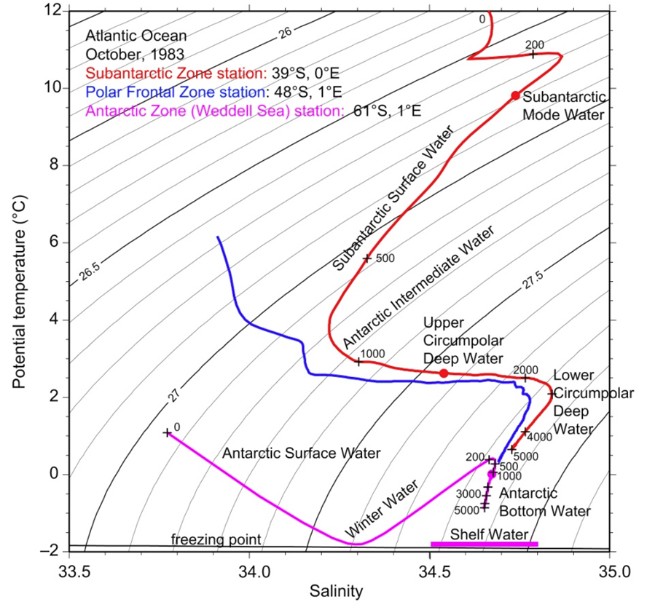

Slide 4
Importance of the Deep Circulation
The deep circulation carries heat, salinity, oxygen, CO₂ , and other properties from high latitudes in winter to lower latitudes throughout the world. This has very important consequences.
1. The contrast between the cold deep water and the warm surface waters determines the stratification of the ocean, which strongly influences ocean dynamics.
2. The volume of deep water is far larger than the volume of surface water. Although currents in the deep ocean are relatively weak, they have transports comparable to the surface transports.
3. The fluxes of heat and other variables carried by the deep circulation influences earth’s heat budget and climate. The fluxes vary from decades to centuries to millennia, and this variability modulates climate over such time intervals. The ocean may be the primary cause of variability over times ranging from years to decades, and it may have helped modulate ice-age climate.
Two aspects of the deep circulation are especially important for understanding earth’s climate and its possible response to increased carbon dioxide CO₂ in the atmosphere: i) the ability of cold water to store CO₂ and heat absorbed from the atmosphere, and ii) the ability of deep currents to modulate the heat transported from the tropics to high latitudes.

Slide 5
The Global Conveyor Belt
The global oceanic conveyer belt is a unifying concept that connects the ocean's surface and thermohaline (deep mass) circulation regimes, transporting heat and salt on a planetary scale.
The conveyor belt system can be thought of as beginning near Greenland and Iceland in the North Atlantic where dry, cold winds blowing from northern Canada chill surface waters. The combined chilling of surface waters, evaporation, and sea-ice formation produces cold, salty North Atlantic Deep Water (NADW). The newly formed NADW sinks and flows southward along the continental slope of North and South America toward Antarctica where the water mass then flows eastward around the Antarctic continent (in the Antarctic Circumpolar Current).
There the NADW mixes with Antarctic waters (i.e., AABW and AADW). The resulting Common Water, also called Antarctic Circumpolar water, flows northward at depth into the three ocean basins (primarily the Pacific and Indian Oceans).
These bottom waters gradually warm and mix with overlying waters as they flow northward. They move to the surface at a rate of only a few meters per year. After rising to the surface in the Pacific, the surface waters flow through the many passages between the Indonesian islands into the Indian Ocean.
Eventually they flow into the Agulhas Current, the Indian Ocean boundary current that flows around southern Africa. After entering the Atlantic Ocean, the surface waters join the wind-driven currents in the Atlantic, becoming saltier by evaporation under the intense tropical sun. Trade winds transport some of this water vapor out of the Atlantic Ocean basin, across the Isthmus of Panama, and into the Pacific Ocean basin. Atlantic surface waters eventually return northward to the Labrador and Greenland seas in the North Atlantic.
Continued operation of the oceanic conveyor belt is important to northern Europe's moderate climate because of northward transport of heat in the Gulf Stream and North Atlantic Current. The system can weaken or shut down entirely if the North Atlantic surface-water salinity somehow drops too low to allow the formation of deep-ocean water masses.
This apparently happened during the Little Ice Age (about 1400 to 1850 AD). The conveyer system shut down and northern Europe's climate became markedly colder. Old paintings from this era show Dutch skaters on frozen canals-something that would not occur during today's climatic regime. Cores extracted from deep-sea sediment deposits contain evidence of earlier cold periods.

Slide 6
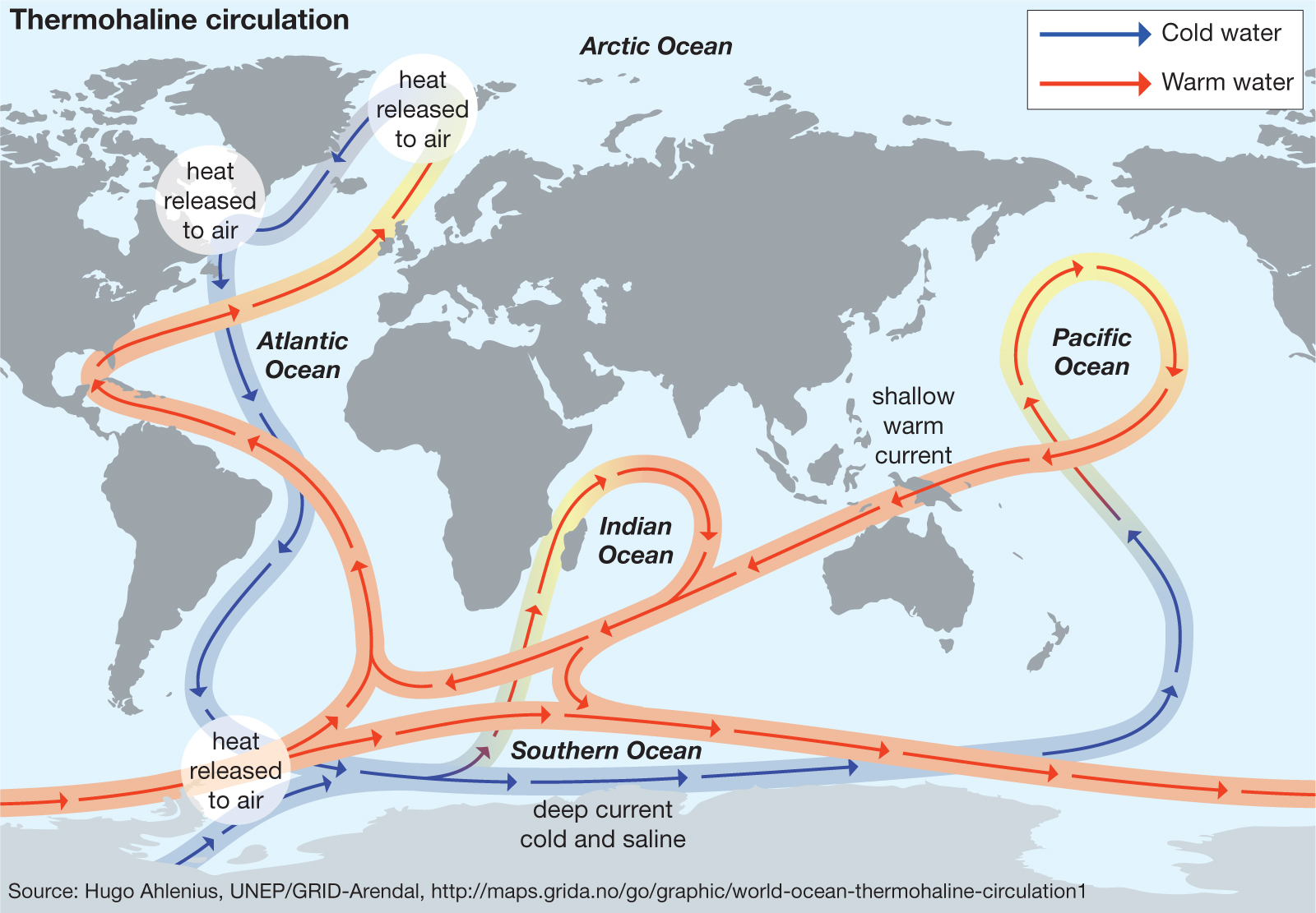
https://www.britannica.com/science/ocean-current/Thermohaline-circulation#ref540531

Slide 7
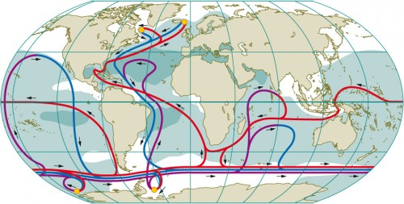
The worldwide ocean currents of the thermohaline circulation system are extremely complex. The flow of cold, saline surface water (blue) downward and toward the equator can only be clearly recognized in the Atlantic. Warm surface water (red) flows in the opposite direction, toward the pole. In other areas the current relationships are not as clear-cut as they are in the Gulf Stream system (between North America and ­Europe). The Circumpolar Current flows around Antarctica, and does so throughout the total depth of the water column. The small yellow circles in the polar regions indicate convection areas. The dark areas are characterized by high salinity and the white areas by low salinity. Salty areas are mostly located in the warm subtropics because of the high evaporation rates here.

